Slide 1
Rumour Detection
SemEval 2019
Submitted By:
Abhijeet Panda, Aniruddha Deshpande,
Darshan Kansagara, Sarvat Ali

Slide 2
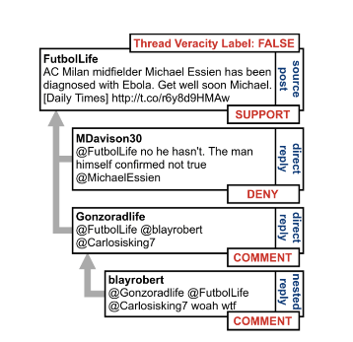
Introduction
Subtask A: Classifying the replies as to whether they Support, Deny, Query or Comment on the source tweet.
Subtask B: Verify the veracity (True, False, Unverified) of the source tweet.
Dataset Used : Twitter Dataset provided by SemEval.

Slide 3
Subtask A: SQDC Classification

Slide 4
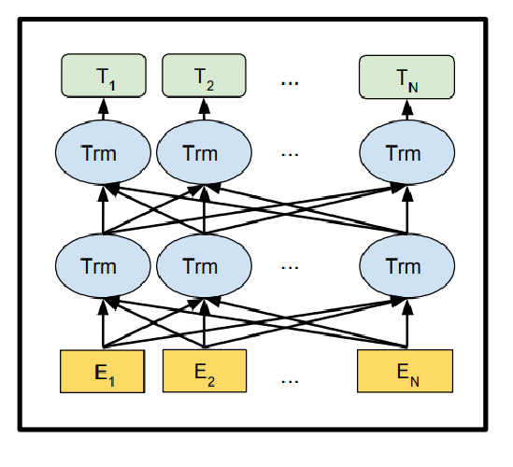
BERT Based Approach
Bidirectional Encoder Representations from Transformers used for context representation.
Pretrained on Large Wikipedia Data Dumps and Corpus of Books.
Pairwise comparison and classification.
Class | Precision | Recall | F1-score
Comment | 0.78 | 0.87 | 0.83
Deny | 0.38 | 0.20 | 0.26
Query | 0.49 | 0.60 | 0.54
Support | 0.50 | 0.29 | 0.37

Slide 5
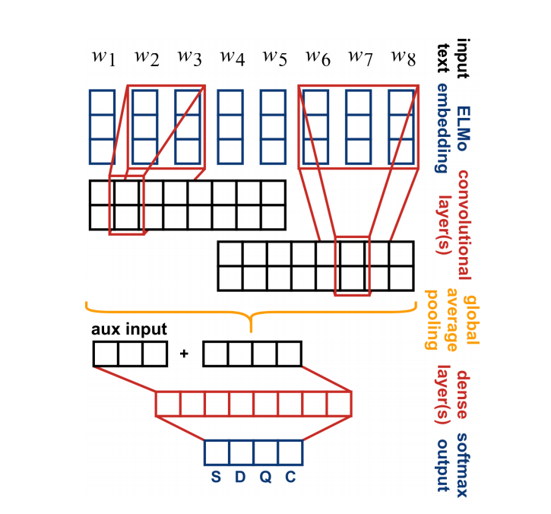
CNN Based Approach with ELMo Embeddings
ELMo Embeddings utilised for obtaining the context based information.
Several Convolutional Layers with Batch Normalization after ReLU Activation.
Class | Precision (in %) | Recall (in %) | F1-score (in %)
Comment | 86.2 | 89.3 | 87.6
Deny | 15.9 | 12.1 | 12.7
Query | 56.9 | 33.5 | 41.7
Support | 40.8 | 37.2 | 36.9

Slide 6
Subtask B: Veracity Classification

Slide 7
Baseline Methodologies
Random Forest
Accuracy Achieved: 0.65
F1 Score Achieved: 0.57
Decision Tree
Accuracy Achieved: 0.58
F1 Score Achieved: 0.52
Gradient Boosting
Accuracy Achieved: 0.6
F1 Score Achieved: 0.52

Slide 8
RNN and BERT Based Models
As proposed in our Scope document, along with Baseline methodologies, 2 more classifiers based on RNN and BERT were developed for the Veracity Classification task. The Hyperparameters used are mentioned in the Final Deliverable Document.
Accuracy of 0.55 after k5 and k fold cross-validation for the RNN based model as training data is small.
Class | Precision | Recall | F1-Score
False | 0.57 | 0.67 | 0.62
True | 0.74 | 0.65 | 0.69
Un_verified | 0.62 | 0.68 | 0.65

Slide 9
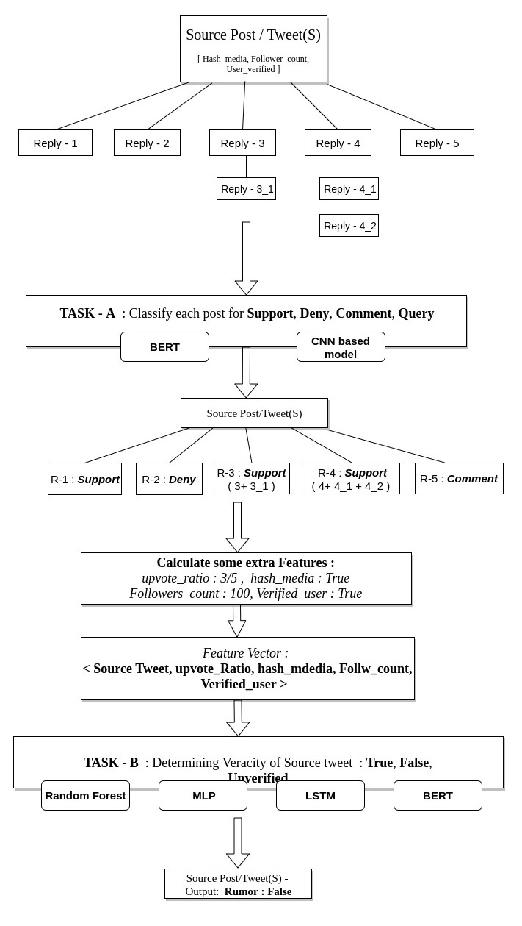

Slide 10
Thank You

